Slide 1
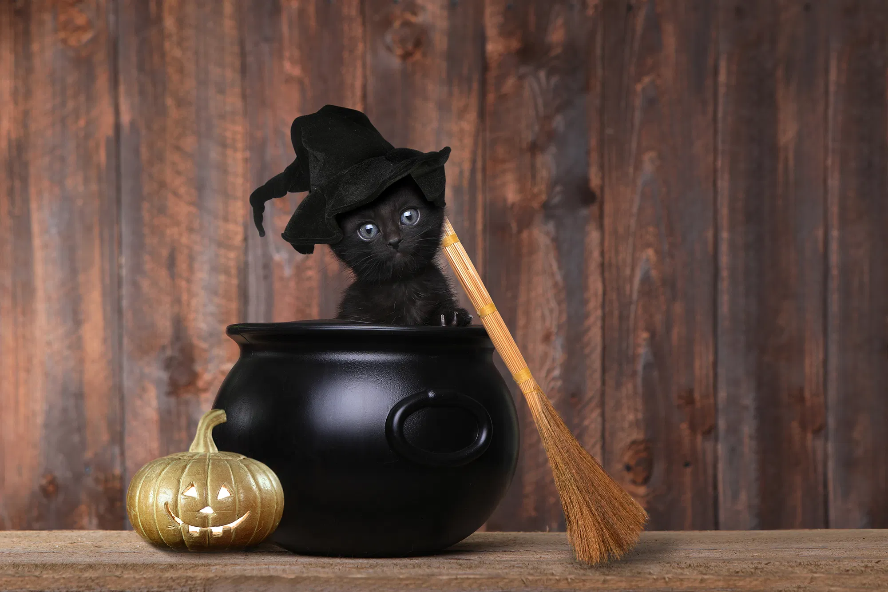
WELCOME!

Slide 2
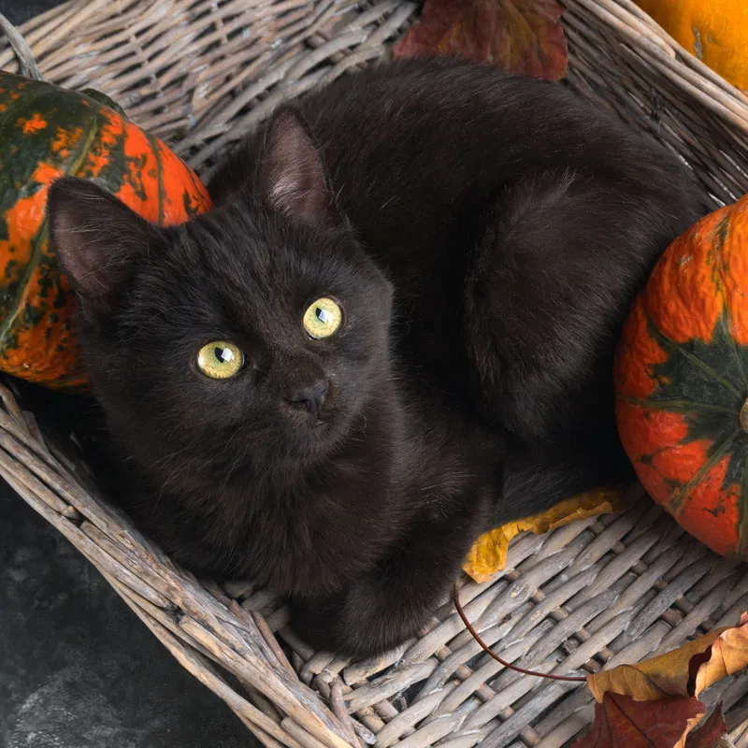
Overview
Intro
Tales from the Cryptoparty!!!
Q&A
Outro

Slide 3
Who are we?
We are…
The Cypurr Collective: A group of folks that organize cybersecurity events, looking to spread knowledge and talk about privacy rights!
Established April 2016
3-4 cryptoparty, discussion, and social events every month in NYC!
Just some folks interested in making safer spaces for others to talk bout their privacy needs

Slide 4
A few rules for this workshop …
Share the space - Feel free to ask questions in the chat! Or, save them for the Q/A!
Stack! - If we’re asking for vocal discussion, please use the “hand” icon to let us know you’re interested in speaking b4 you unmute!

Slide 5
A few rules for this workshop …
Saf(er) Space - We DO NOT tolerate language or behavior purposefully meant to demean or harm folks based on their identities a.k.a WE WILL BOOT ZOOM BOMBERS!
Photo/Video - Slides/Resources available after!
Bonus Rule- Be mindful of the Mute button!

Slide 6
And now….

Slide 7
….The Cypurr Collective Presents...

Slide 8
….in association with Cypurr Productions LTD...

Slide 9
...a presentation written/directed by the Cypurr Collective...

Slide 10

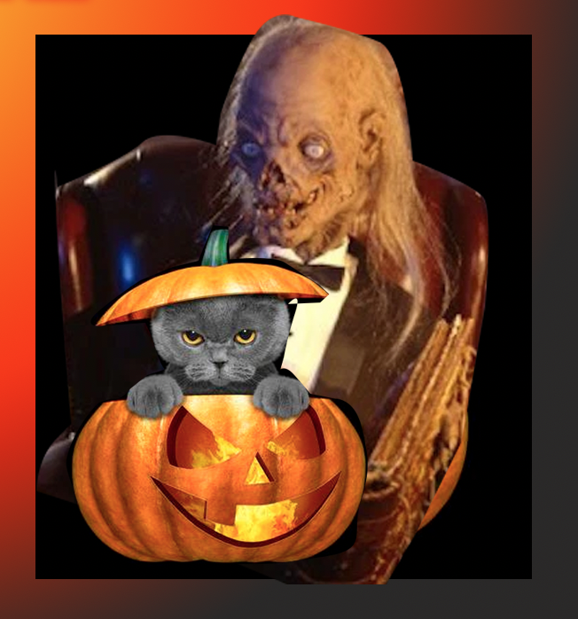

10/24/2020
Exp. 4/20201

Slide 11
or

Slide 12

CAT MIRROR

Slide 13
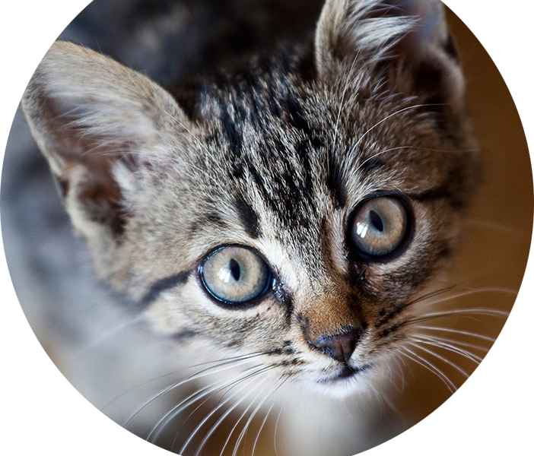
CAT MIRROR

Slide 14
Loosely based on some actual stories...*

Slide 15
Loosely based on some actual stories...*
The veracity of the upcoming stories may or may not be based on things that I came up with this mornign as I was finalizing thiis presentation. I had a dream that I missed this presentation so i’m really glad to be here and not dropped the cat ball so to speak. In my dream I was pantsless on the side of the road and forlorn and didn’t know how I was going to make it up to the the library the cypurr folk and our adoring fans but then I woke up and started pacing around the apartment and putting it together after a wonderful breakfast from my partner so now i’m here and happy that this nightmare of a morning is over. In other words BY READING THIS PART YOU CAN’T SUE THOUGH THIS IS NO WAY LEGALLY BINDING

Slide 16
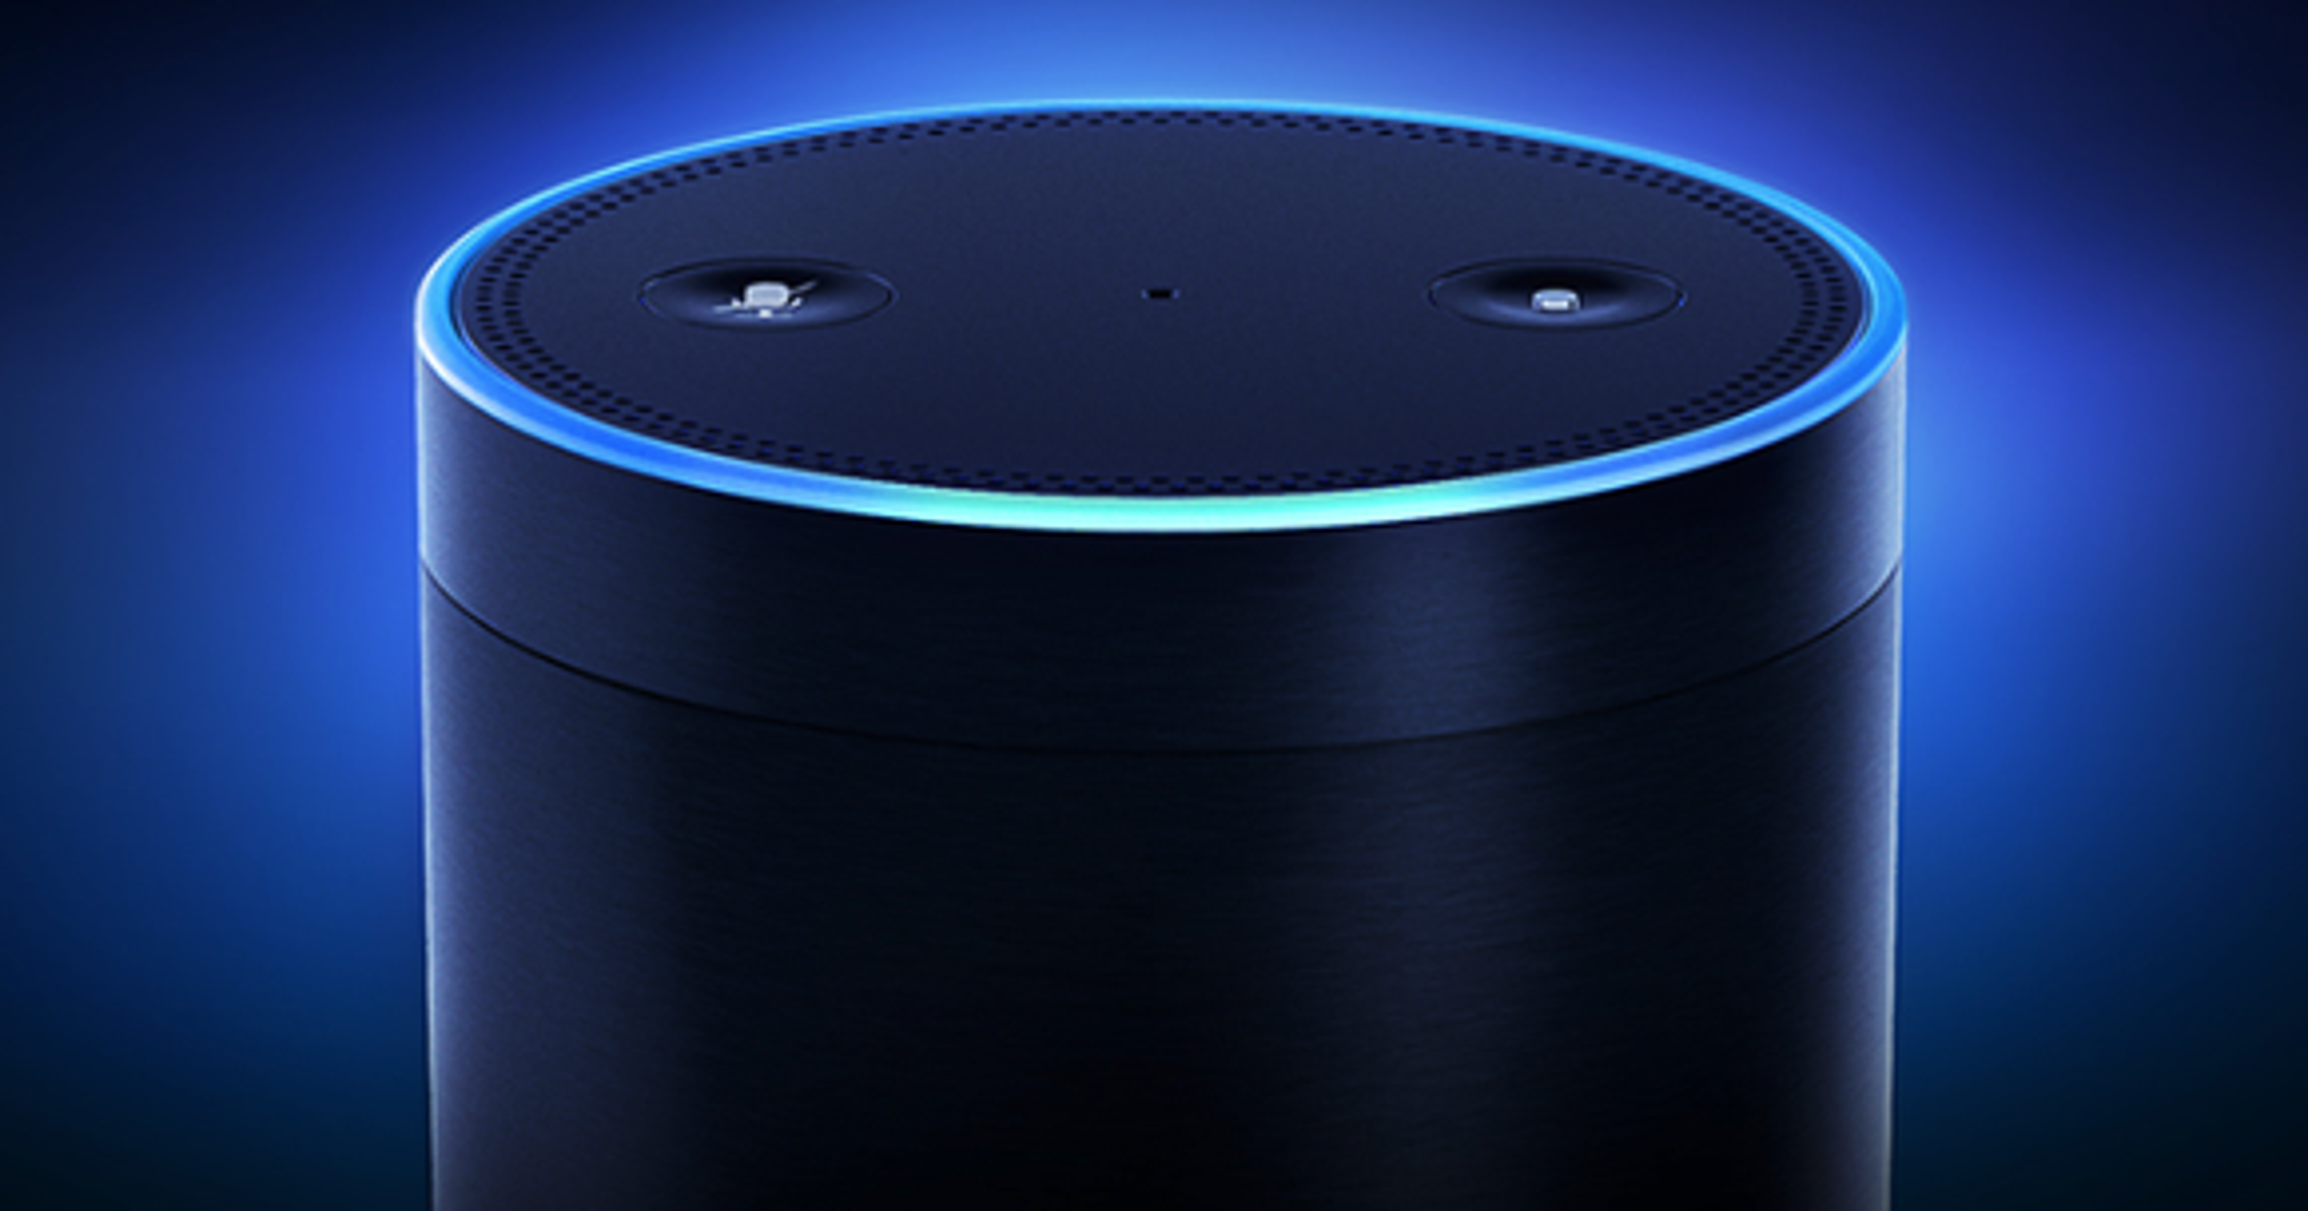
Honorable Mentions

Slide 17

Honorable Mentions

Slide 18
Honorable Mentions
Tesla has a checkered history with the NHTSA
In 2019, investigation into complaints about vehicle fires connected to the battery management systems in some Model S and X vehicles.
multiple fatal crashes involving Autopilot.
probable causes of a fatal 2018 crash, in which a California man was killed

Slide 19
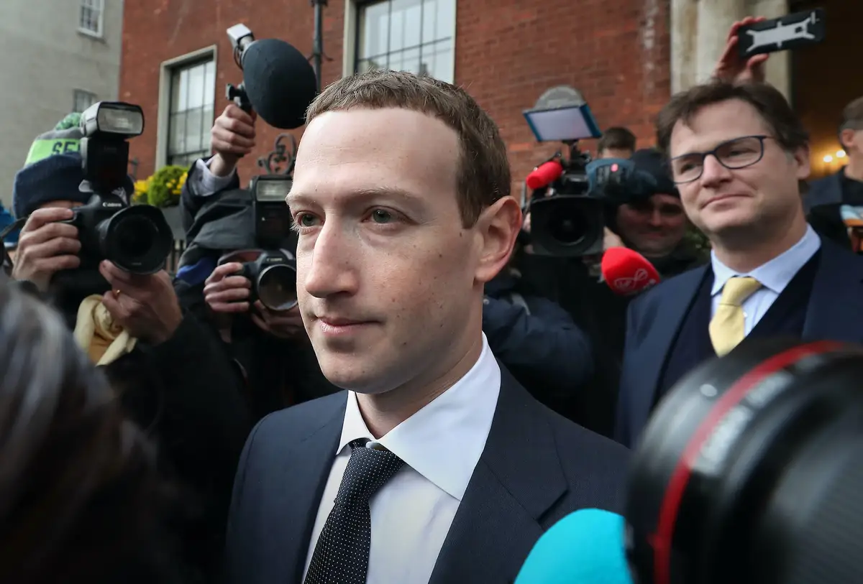
Honorable Mentions

Slide 20
Honorable Mentions
Mark Zuckerberg signed off on a Facebook algorithm change in 2017 that throttled traffic to left-leaning news sites and cost Mother Jones hundreds of thousands of dollars, The Wall Street Journal reported and Mother Jones senior staffers said on Friday.
Mark Zuckerberg signed off on a Facebook algorithm change in 2017 that throttled traffic to left-leaning news sites and cost Mother Jones hundreds of thousands of dollars, The Wall Street Journal reported and Mother Jones senior staffers said on Friday.

Slide 21

Story 1: A Tale of Misinformation

Slide 22

“...dangerous epidemic of misinformation”
“Harmful health advice and snake-oil solutions are proliferating”, Mr. Guterres spelled out. “Falsehoods are filling the airwaves. Wild conspiracy theories are infecting the Internet. Hatred is going viral, stigmatizing and vilifying people and groups”.

Slide 23
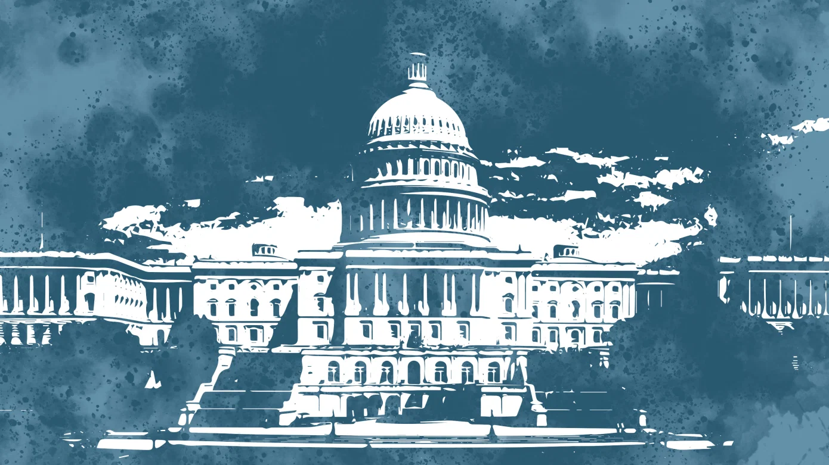
Who To Trust?
Facebook and Twitter CEOs to testify before Congress in November on how they handled the election- TechCrunch
Snopes
Politifact
FactCheck.org
ProPublica

Slide 24

Story 2: A lot of birds, one hack!!

Slide 25

Story 2: A lot of birds, one hack!!
Passphrases
Don’t Repeat!
Password Manager
2FA (2 Factor Authentication)

Slide 26
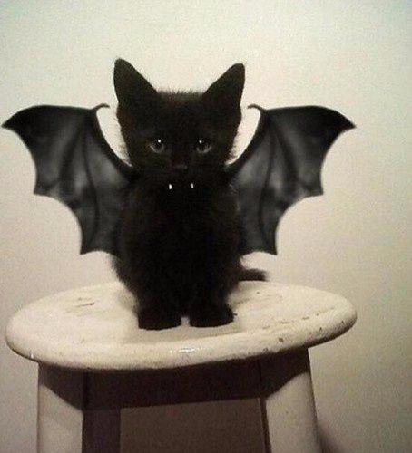
Story 3: Phantom of the INTERWEBS!

Slide 27
Story 3: Phantom of the INTERWEBS!
Google yourself!
PrivacyDuck
MyShdow.org

Slide 28
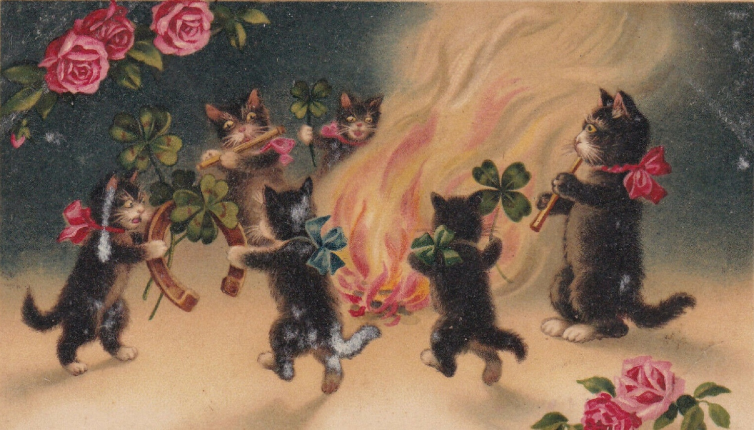
Campfire Tales (Q and A and story share)

Slide 29

Further Resources
Cypurr Collective - cypurr.nyc
Facebook @cypurrnyc
Twitter @cypurrnyc
cypurr@protonmail.com
Bongo.cat

